Slide 1
Chapter 11 : data fitting using MATLAB
Regression (Data fitting, Least square problem)
Best fitting function
(goodness of the fitting)
Fit command details :
  Centering & scaling
  Creat fit options and fittype
Interactive curve (data) & surface fitting

Slide 2
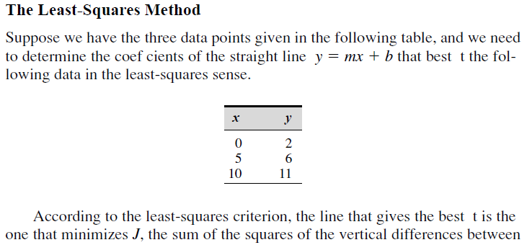
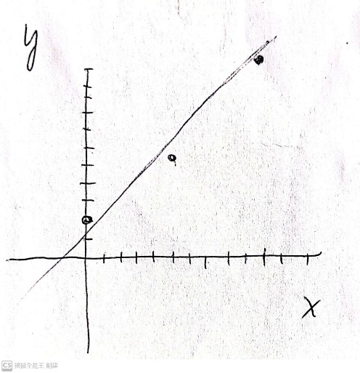
The least square problem
the best fit line is the one that minimizes J,
: sum of the squares of the vertical
differences between the data points and the line.
called residuals.

Slide 3
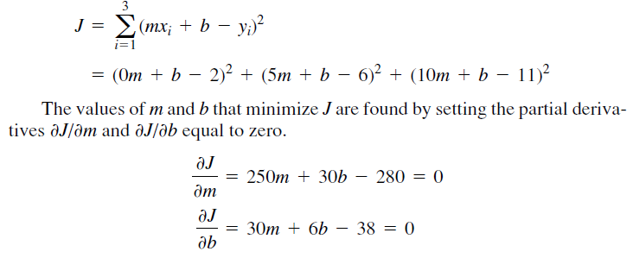
The vertical differences between the line and the data points.
m=0.9, b=11/6

Slide 4
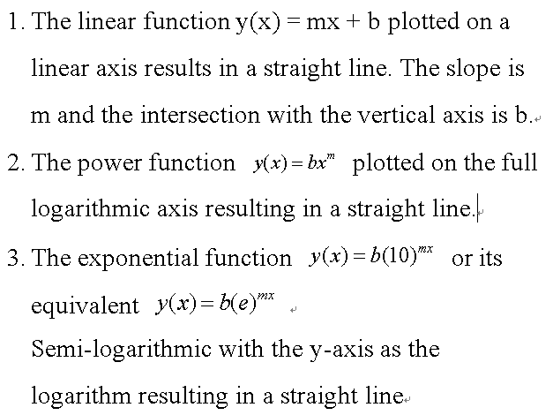
Use linear, power, and exponential functions to describe data
Each function will be a straight line when plotted for the axes
specified in the following columns.

Slide 5
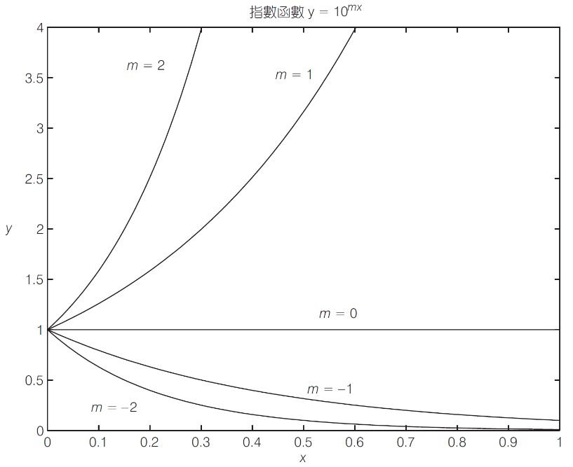
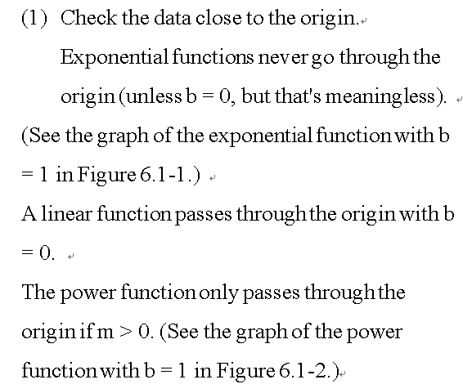
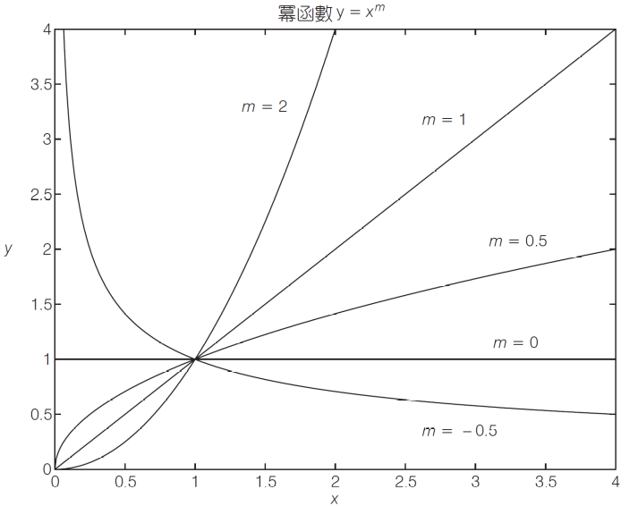
Processing steps to find the fitting function (linear, power, exponential) function.

Slide 6
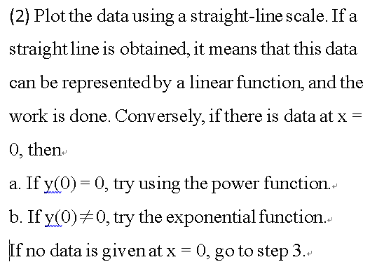

Slide 7
If you suspect a power function, plot the data points on the full-log scale. -- a straight line on a full-logarithmic plot.
exponential function, plot the data on a semi-log scale. -- a straight line on a semi-logarithmic graph.
4. we use full-log or semi-log plots to identify function types, but do not obtain coefficients b and m, one use the polynomial fitting for power & exponential

Slide 8
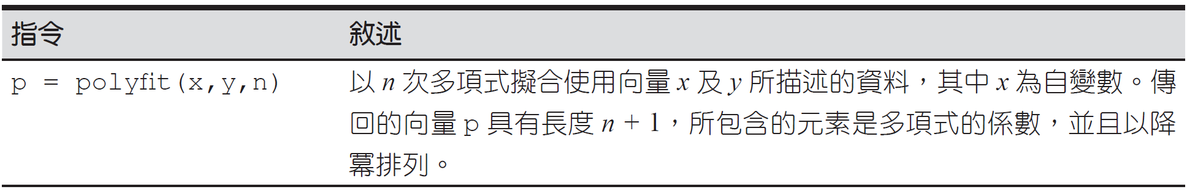
圖 6.1–1 polyfit函數

Slide 9
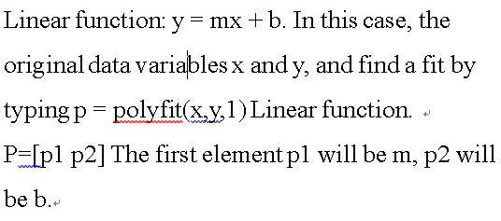
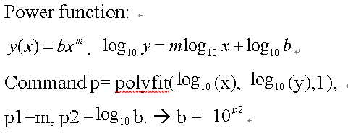
Use polyfit to fitting the data

Slide 10
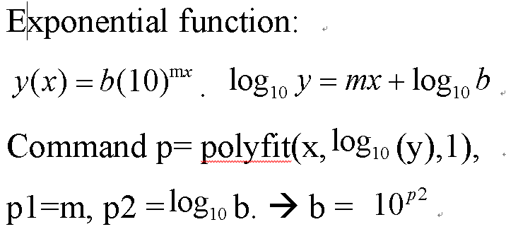
Two examples

Slide 11
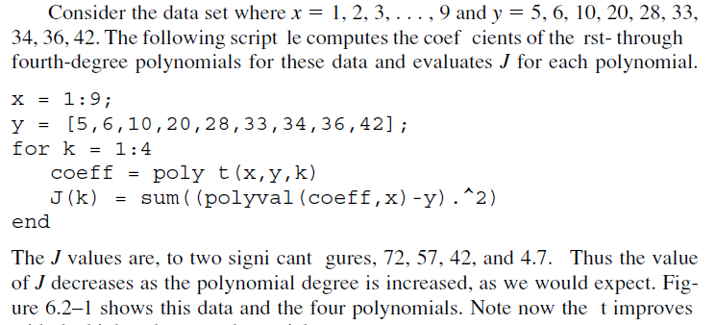
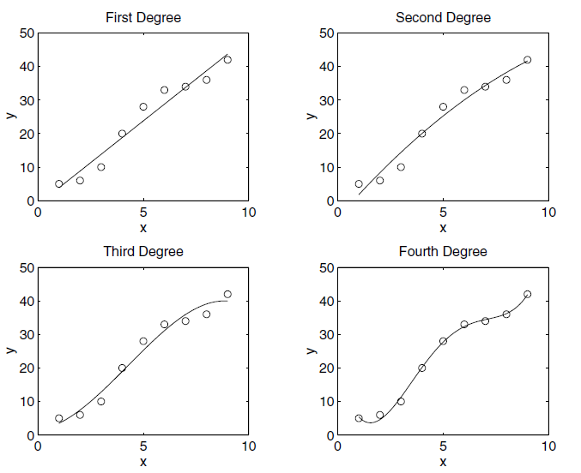
polyfit

Slide 12
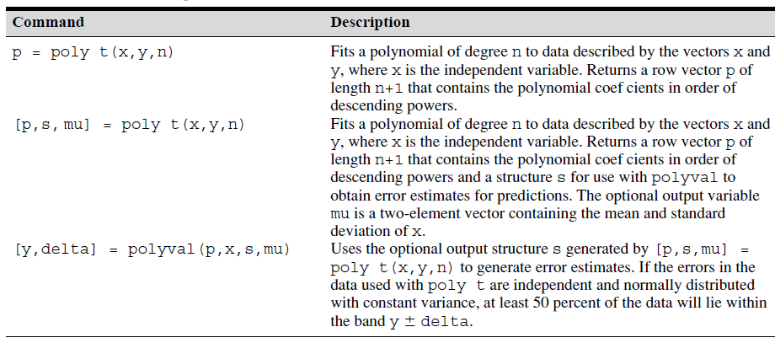
Polynomial regression ｆｕｎｃｔｉｏｎ
polyfit
polyfit

Slide 13
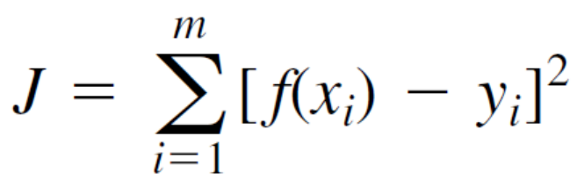
how well the curve fits
We can use the J value to compare how well the curve fits two or more
functions describing the same data.
The function that yields the smallest J value has the best fit to the data..

Slide 14

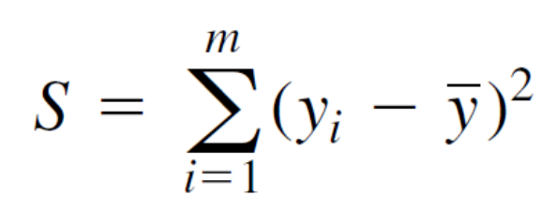
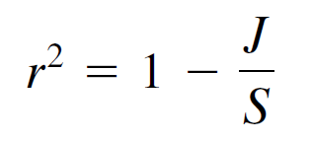
The sum of the squares of the amount
of difference between our label value y and the mean is S,
which we can calculate by the following formula
For a perfect fit, J = 0 and r ^{２} = 1.
Therefore, the closer r ^{２} is to 1,
the better the fit r ^{２} is at most 1.
J may be greater than S, so r ^{２} may be negative. If this happens, it means that this is a very bad model.
As a rule of thumb, a good fit should account for at least 99% of the variance in the data. This value corresponds to r ^{２} ＞＝0.99.

Slide 15
Three examples of the data fitting
Goodness by using r square
Use centering and scaling to improve numerical properties
Create Fit option and Fit type before fitting
Interactive curve (data) and surface fitting
Exercise

